Slide 1
EGR101 SIM
- - - SPRINT 4 DEMO - - -
Emily Connearney, Luke Crump,
Vivian Dang, Daniel Khalil,
Keely Mashburn

Slide 2
Project Description
An application that allows virtual bot design with:
component configuration
wiring layout
3D simulation
Packaged with an Arduino IDE.

Slide 3
Project Use
Students couldn’t do hands-on due to COVID-19.
Cheaper alternative to buying an $85 kit.
Fully emulates EGR101.

Slide 4
Assumptions/Dependencies
Constraints
Students are familiar with the kit and its components ​
Students understand assigned task and what to do ​
Only the professor can add additional components/pieces to the kit ​
The application can run on different operating systems ​
​Project is constrained by the kit provided to the EGR 101 students ​
Cannot have functionality or components that the actual robot and kit does not have

Slide 5
Fall Semester
Wiring Interface
Simulation Functionality
Most Models Completed
Arduino Interface

Slide 6
Major Sub-Systems
​Design/Wiring Interface
Arduino IDE
Arduino Emulation

Slide 7
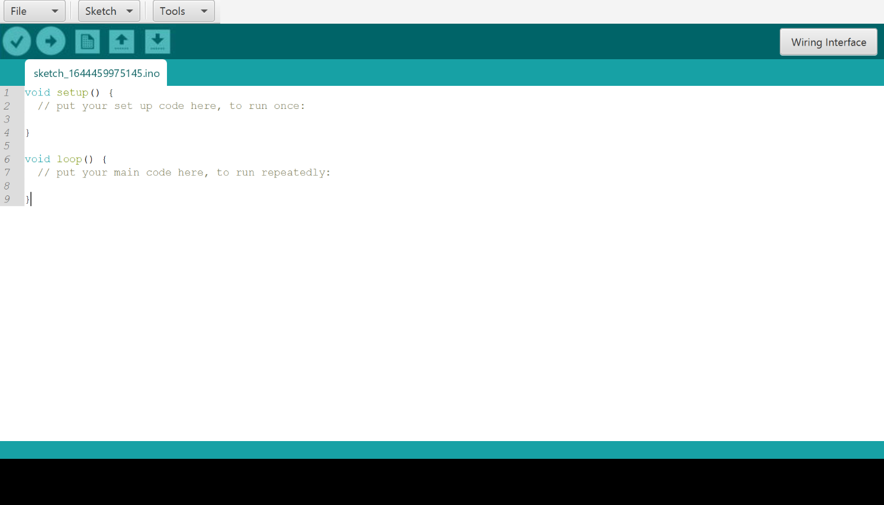
Arduino IDE
Progress

Slide 8
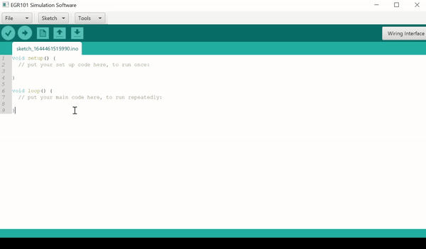
Arduino IDE
Progress

Slide 9
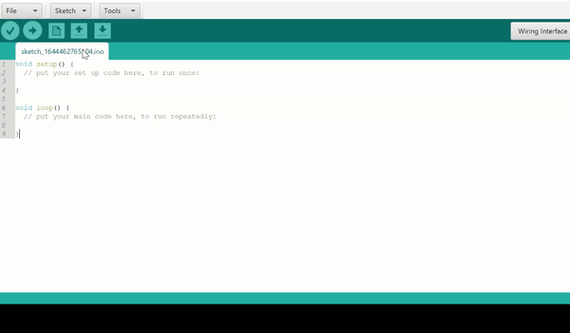
Arduino IDE
Progress

Slide 10
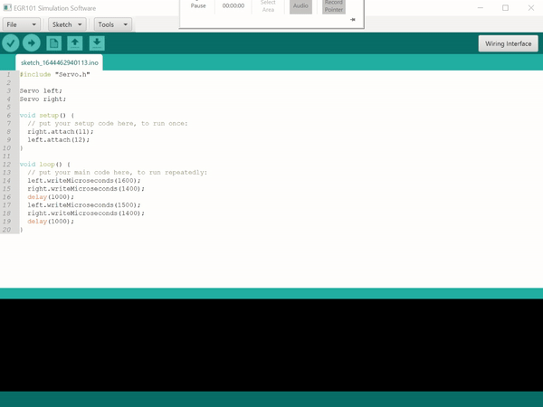
Arduino IDE
Progress

Slide 11
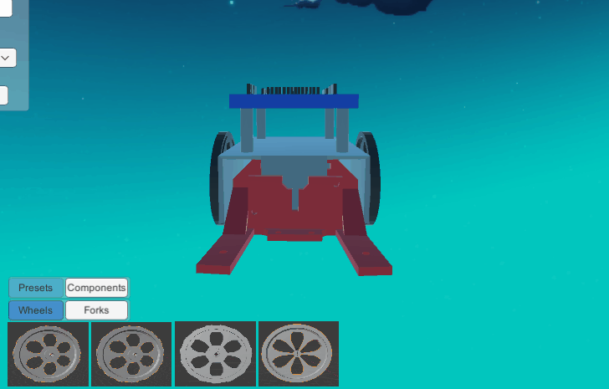
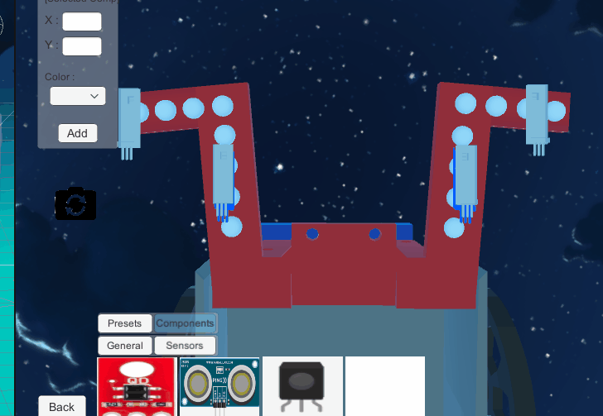
Bot Customization Menu
create new components
snap components
select added components
delete or modify position of added components

Slide 12
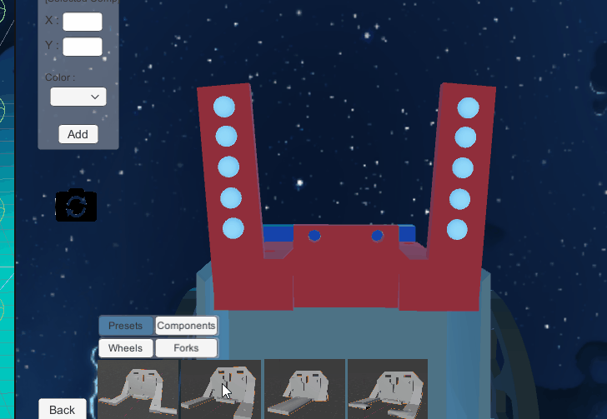
Bot Customization Menu
Mount preset functionality with:
4 different mount types
4 IR sensor array configurations

Slide 13
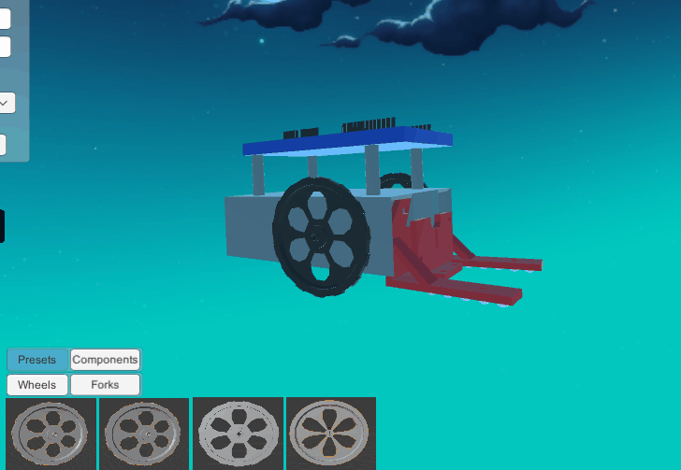
Bot Customization Menu
4 different wheel presets

Slide 14
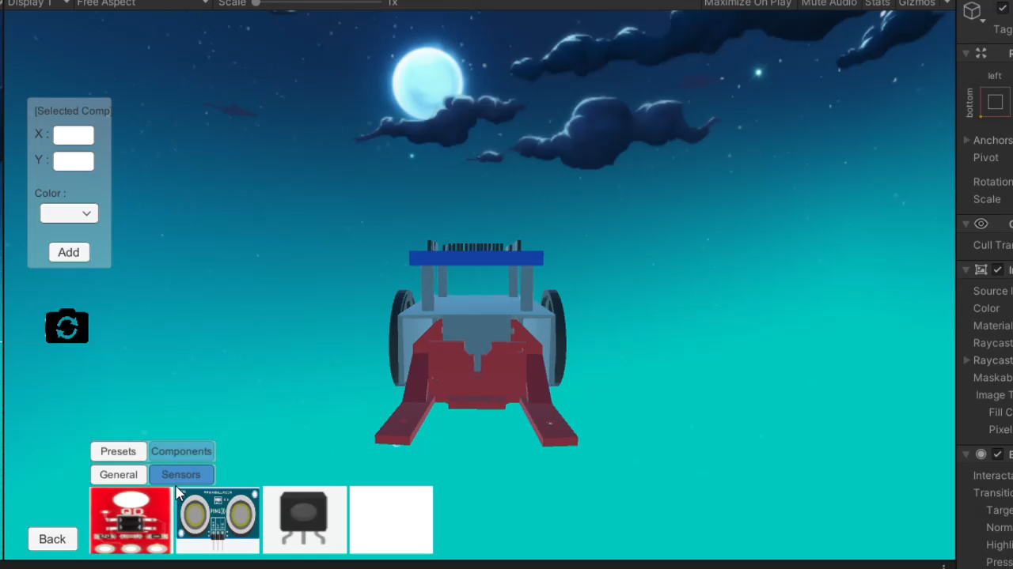
Bot Customization Menu

Slide 15
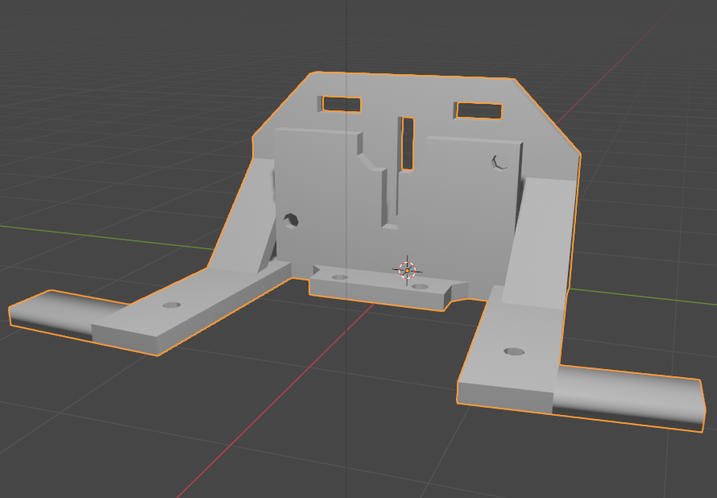
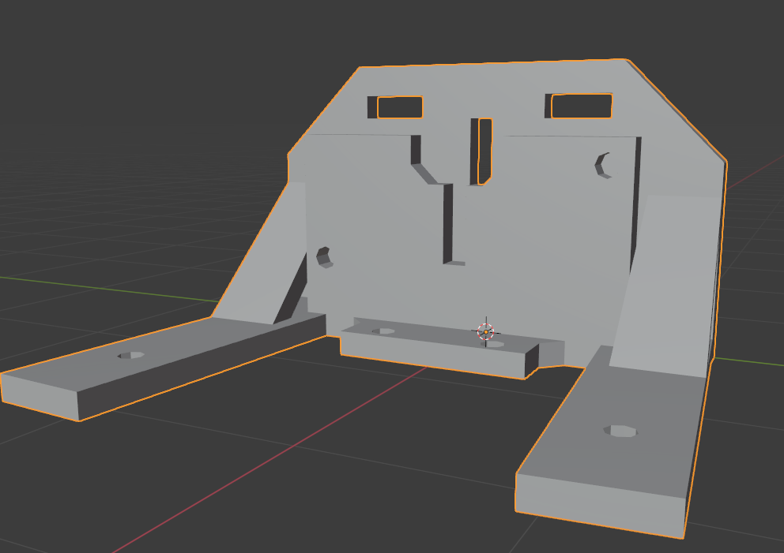
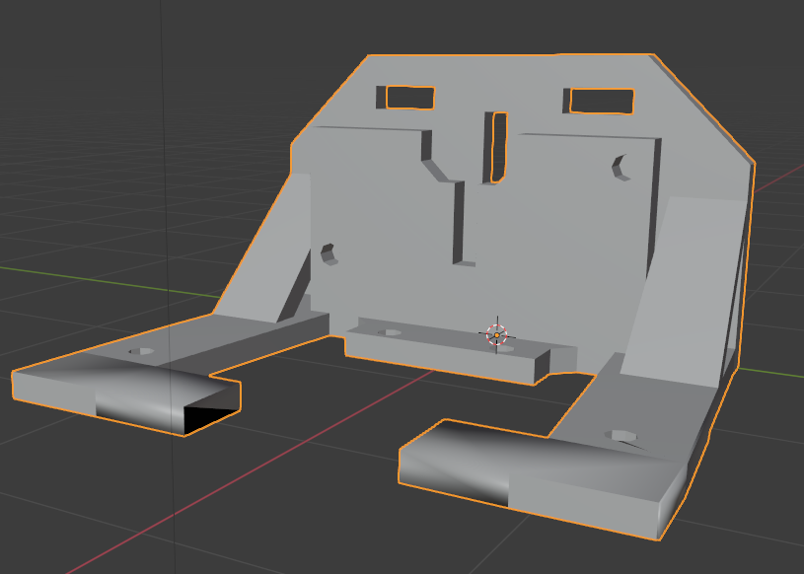
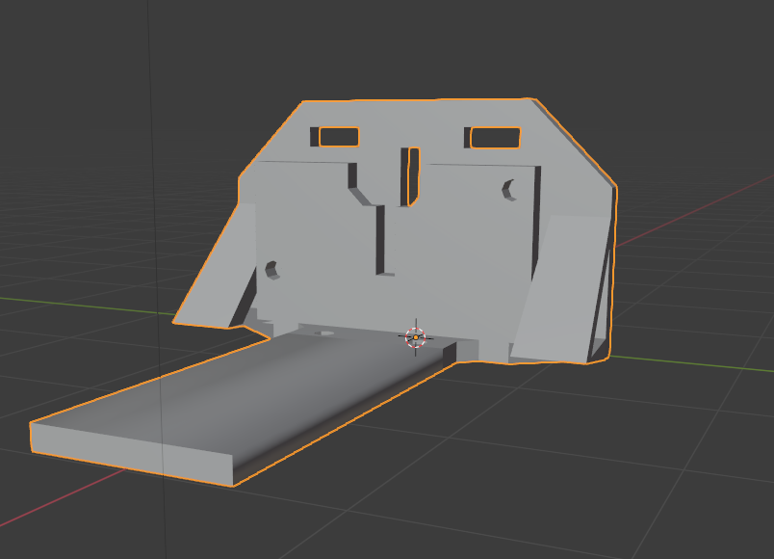
Models

Slide 16
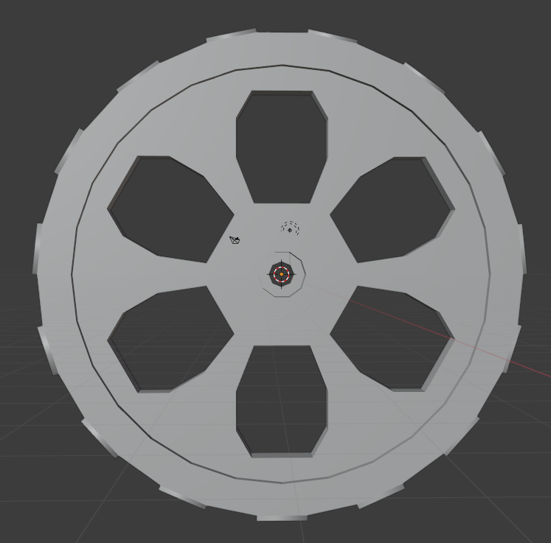
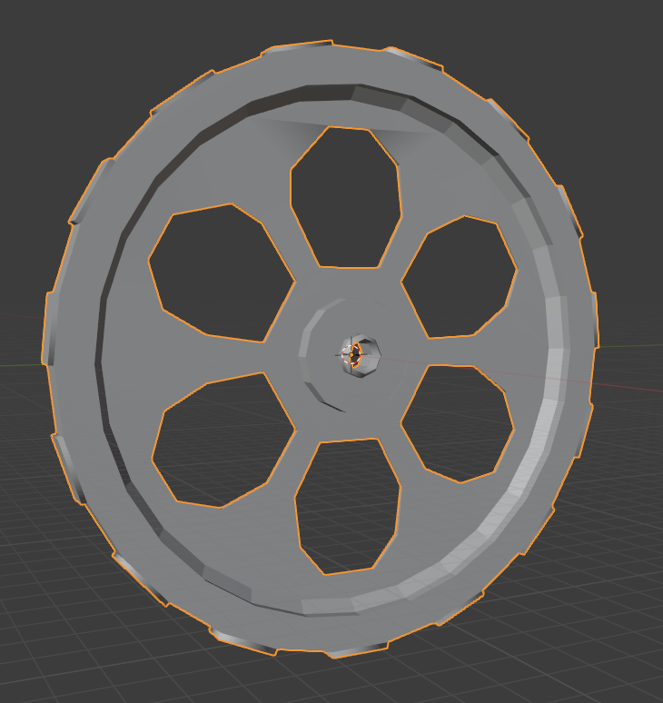
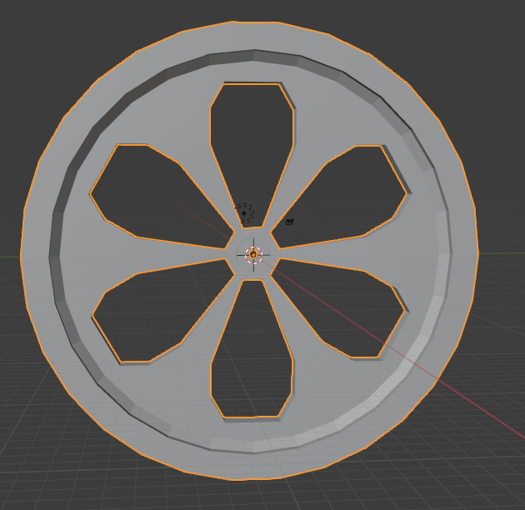
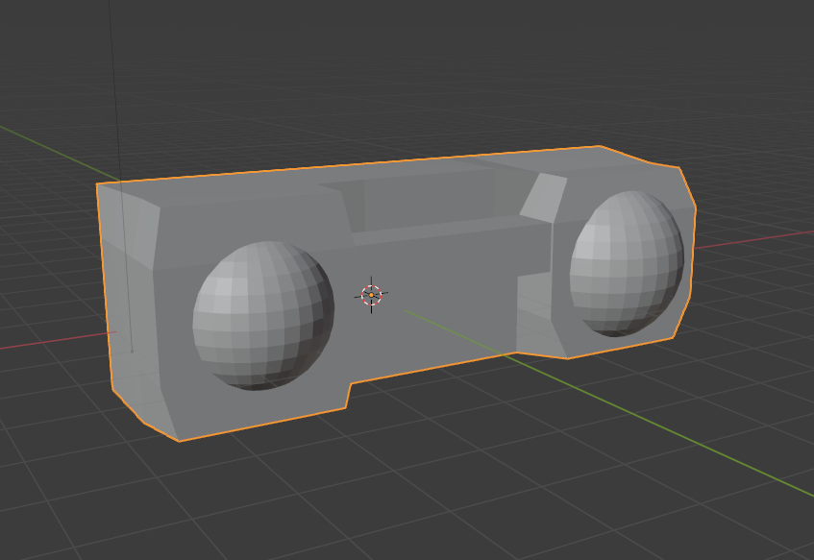
Models

Slide 17
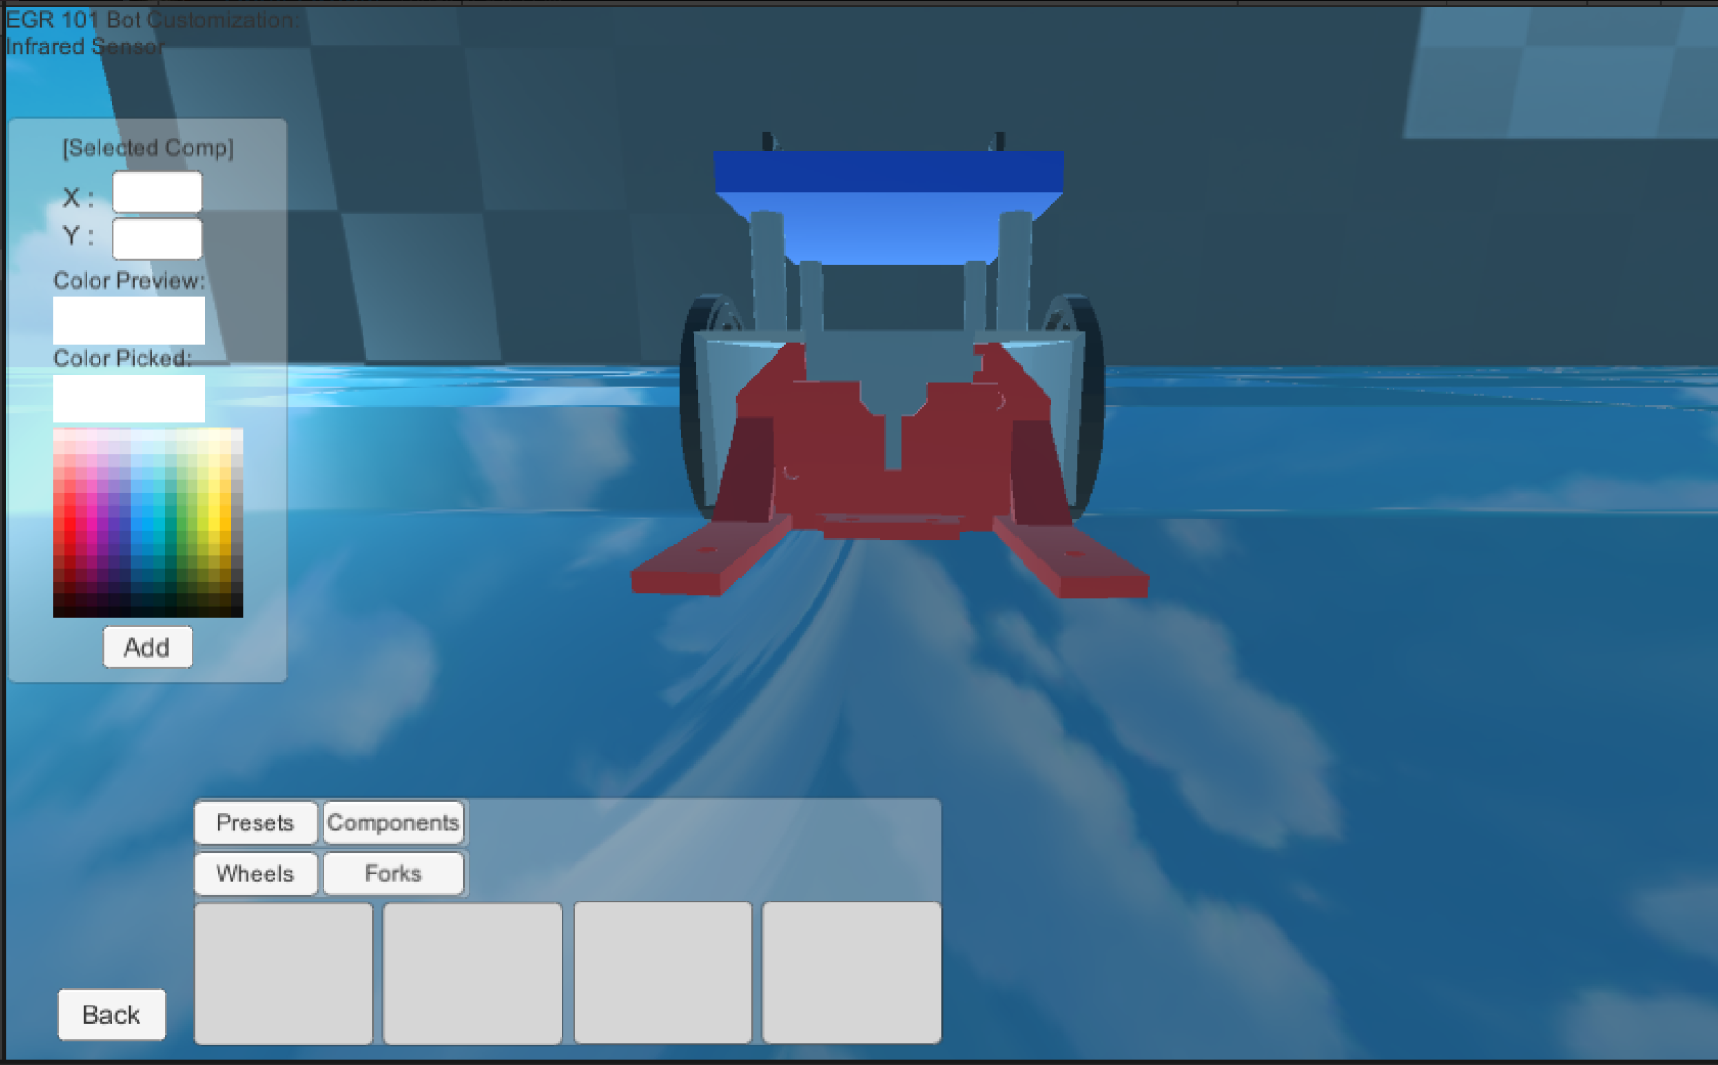
Color Picker
Changes colors of individual components

Slide 18
Bugs
TCP/UDP
Fixed TCP bug by switching to UDP
Wiring
Wirecast isn’t touching pin
Bug Document

Slide 19
Semester Timeline
SPRINT 4
SPRINT 5
SPRINT 6
Bot customization functionality
IDE styling and functionality improvements
Completed more models
Bot wiring functionality
Bot simulation updates components from customization
Improve the GUI
Bug fixes
Polishing

Slide 20
Lessons Learned
Start work earlier
Distribute more comprehensive tasks
Communicate more
Be more cautious when merging

Slide 21
THANK YOU!
Any questions?

